Slide 1

Key to Success
By
Sufiyaan Usmani
K21-3195

Slide 2




Agenda
Training
Resources
Commitment
Need for Training

Slide 3

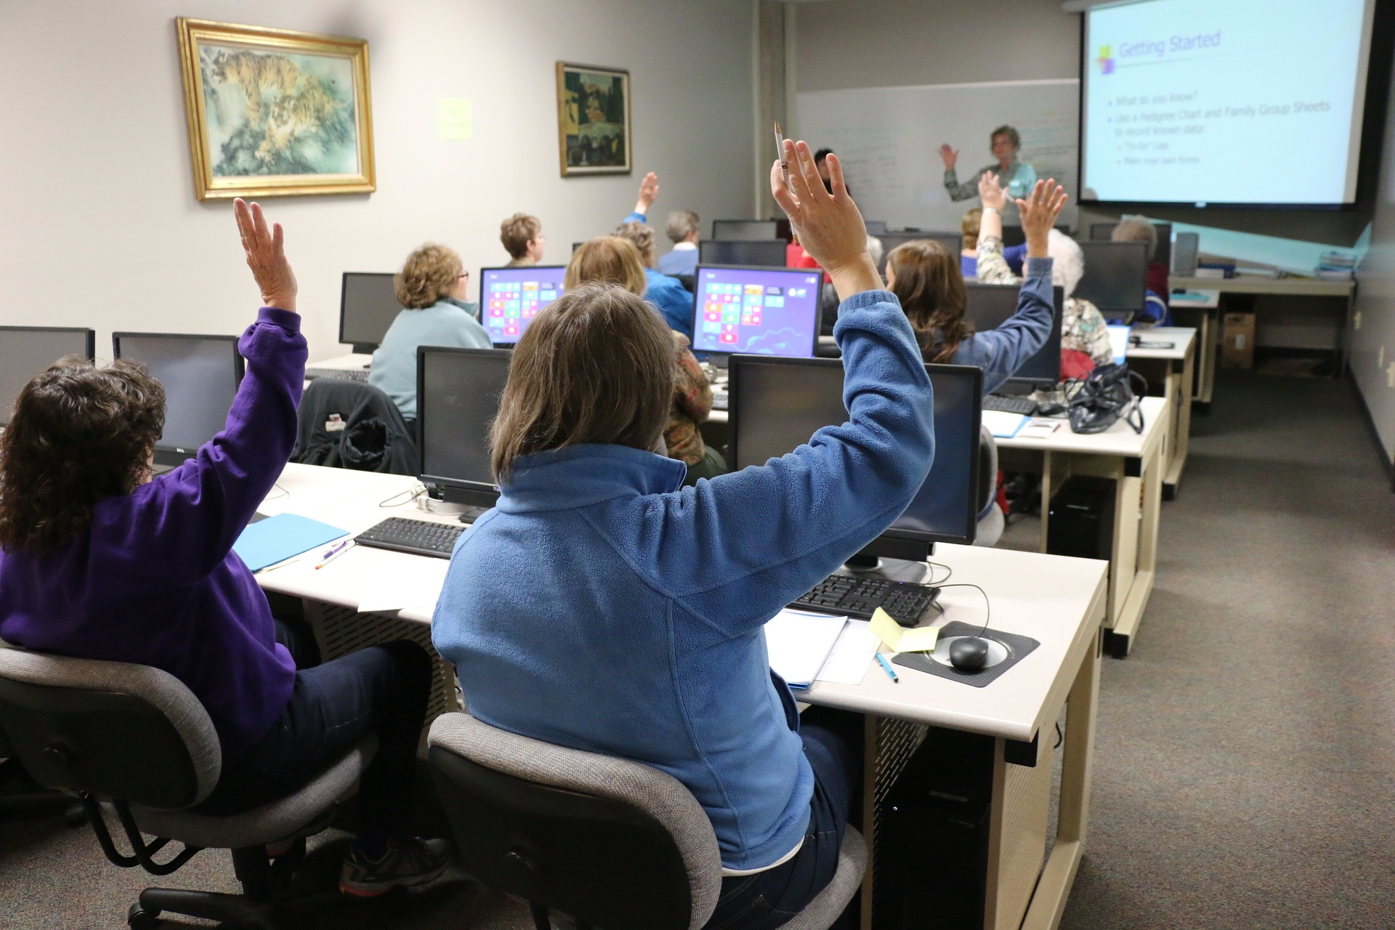

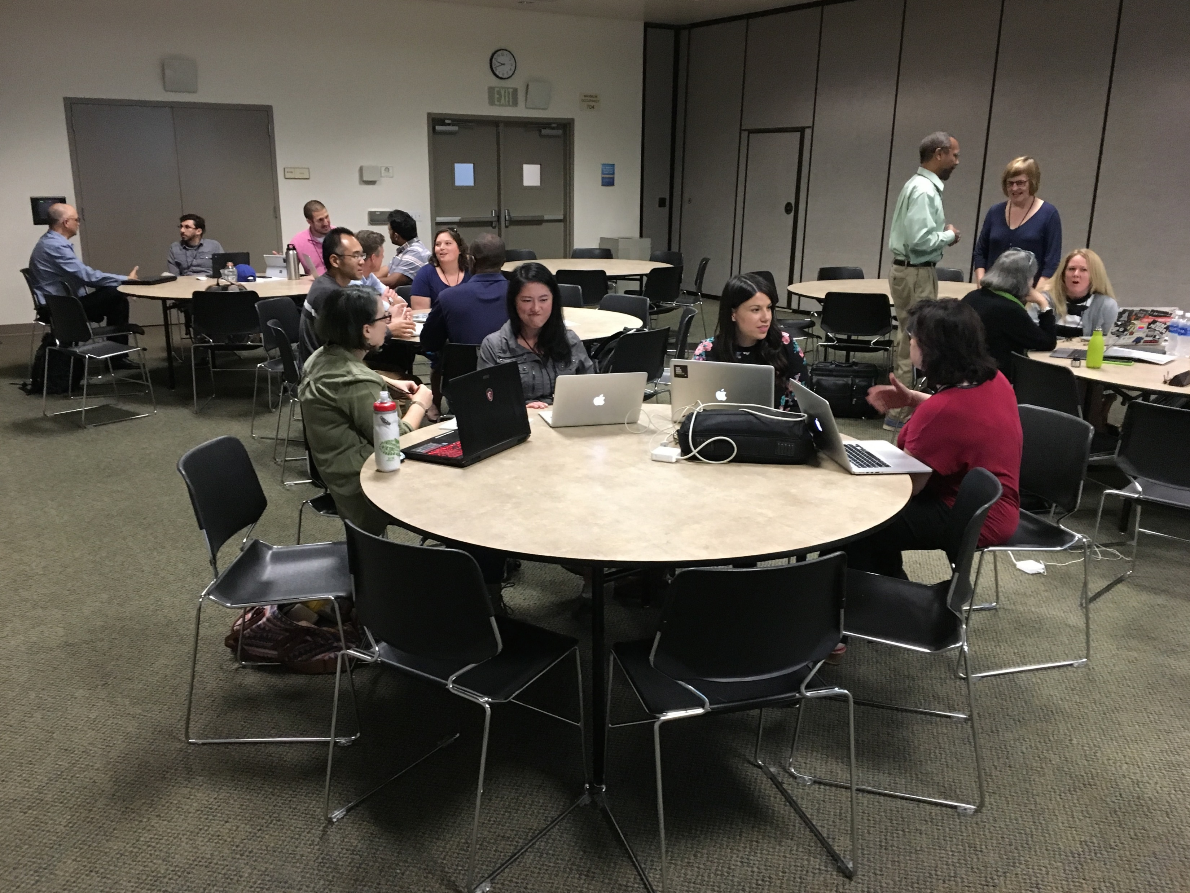
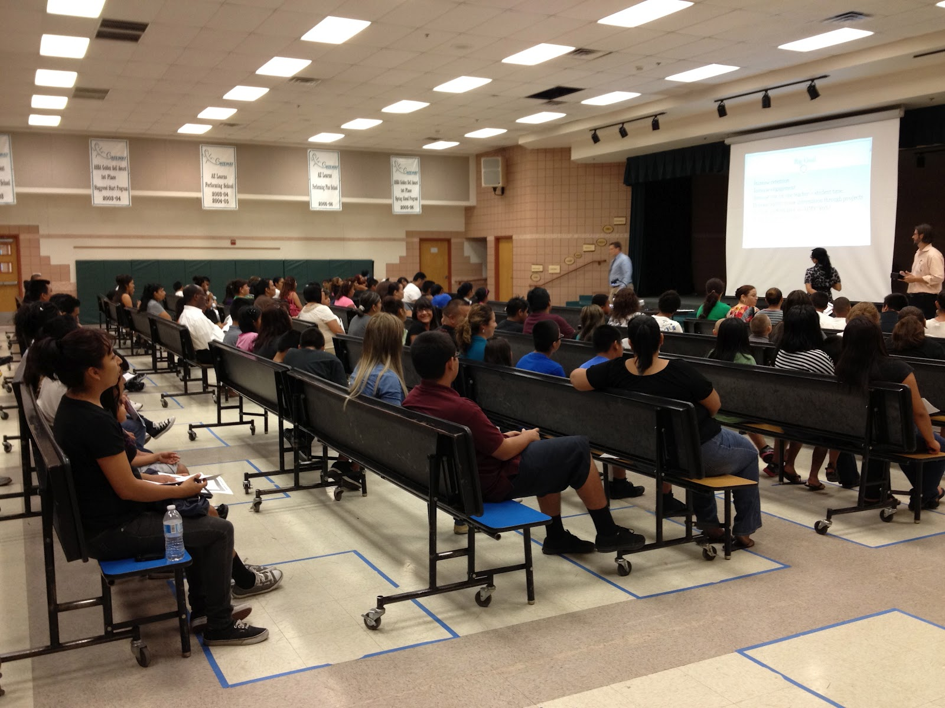
Types of Training
Computer-base training (CBT)
User learn from the computer
Simple & Fast
Instructor led training
Instructor walk through
Engaged learning
Blend of discussion and hands-on learning

